Slide 1



Becky Potter
November 2023

Slide 2
Outline
Executive Summary
Introduction
Methodology
Results
Conclusion
Appendix

Slide 3

Executive Summary
Summary of methodologies
Data Collection (API and Web Scraping)
Data Wrangling
Exploratory Data Analysis using SQL
Exploratory Data Analysis with Visualization (Pandas and Matplotlib)
Interactive Visual Analytics with Folium
Interactive Dashboard with Plotly Dash
Machine Learning Predictive Analysis
Summary of all results
Exploratory Data Analytics results
Interactive Visuals and Dashboards
Predictive Machine Learning Analytics

Slide 4
Introduction
Project background and context
In this project, we will predict if the Falcon 9 first stage will land successfully. SpaceX advertises Falcon 9 rocket launches on its website, with a cost of 62 million dollars; other providers cost upward of 165 million dollars each, much of the savings is because SpaceX can reuse the first stage. Therefore, if we can determine if the first stage will land, we can determine the cost of a launch. This information can be used if an alternate company wants to bid against SpaceX for a rocket launch.
Problems you want to find answers
Determine if the Falcon 9 first stage will land successfully.
Determine the price of each launch.
Determine if SpaceX will reuse the first stage.

Slide 5
Methodology
Executive Summary
Data collection methodology:
Data was collected from SpaceX REST API (data on launches, the rocket used, payload delivered, launch specifications, landing specifications, and landing outcome) as well as data collected by web scraping from Wiki (using Python BeautifulSoup package to web scrape HTML tables that contain valuable Falcon 9 launch records).
Perform data wrangling
Find patterns in the data and determine what would be the label for training supervised models. Deal with missing values by calculating the mean of column and replacing values in dataset.
Perform exploratory data analysis (EDA) using visualization and SQL
Perform interactive visual analytics using Folium and Plotly Dash
Perform predictive analysis using classification models
How to build, tune, evaluate classification models

Slide 6
Data Collection
Data from SpaceX REST API
Request rocket launch data from SpaceX API using a GET request:
spacex_url=https://api.spacexdata.com/v4/launches/past
response = requests.get(spacex_url)
Decode the response content as a Json using .json() and turn it into a Pandas dataframe using .json_normalize()
Data of Falcon 9 Launch data from web scraping Wiki pages
https://en.wikipedia.org/wiki/List_of_Falcon_9_and_Falcon_Heavy_launches
Perform an HTTP GET method and create a BeautifulSoup object from the HTML response
Collect all relevant column names from the HTML table header, create a data frame by parsing the launch HTML tables and create a dataframe.

Slide 7
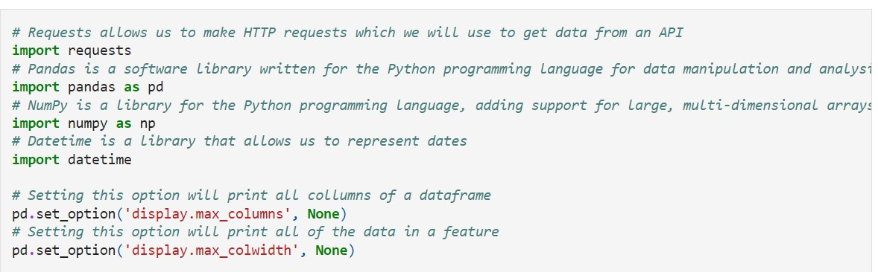
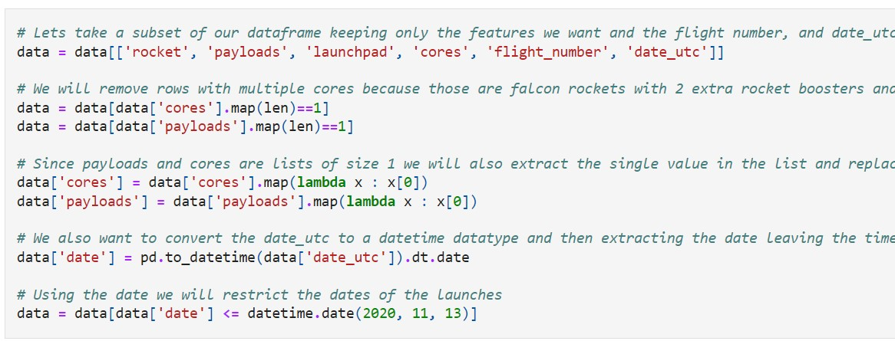
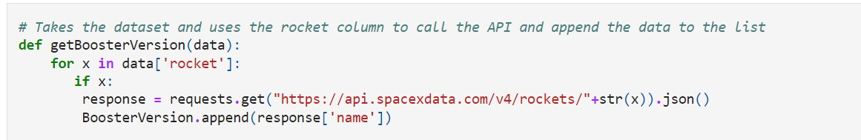
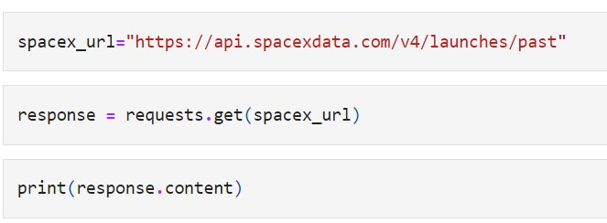
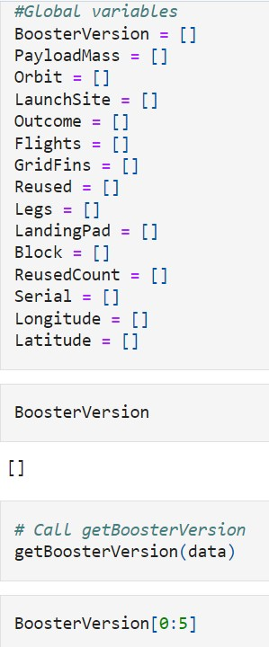
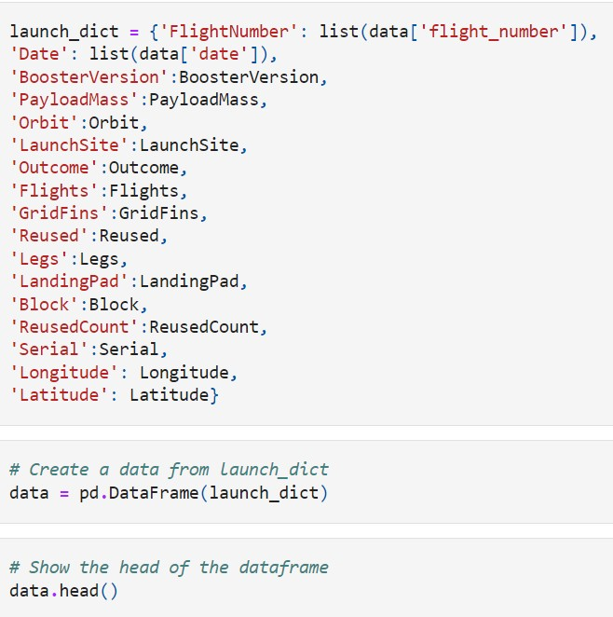
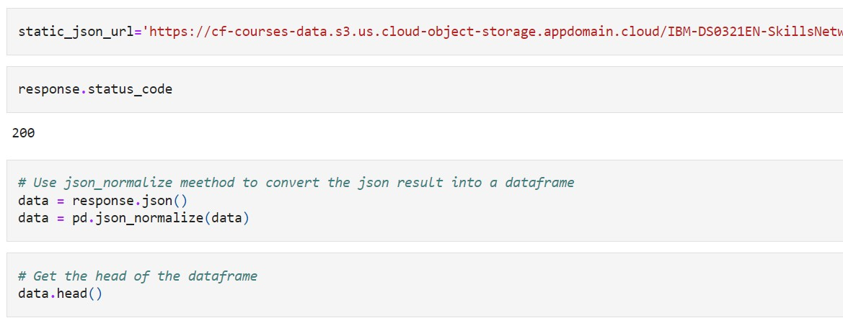
Data Collection – SpaceX API
1. Import requests allows us to make HTTP requests which we will use to get data from an API
2. Take the dataset and use the rocket column to call the API and append the data to the list. Repeat for Launchpad, Payloads and Cores.
5. Get information about the launches using the IDs given for each launch. Specifically, we will be using columns rocket, payloads, launchpad, and cores
3. Send GET request to API
6. Requests are stored in lists and used to make a new data frame
4. Decode the response content as a Json using .json() and turn it into a Pandas dataframe using .json_normalize()
7. Combine columns into a dictionary and show a summary of the data frame.
GitHub URL

Slide 8
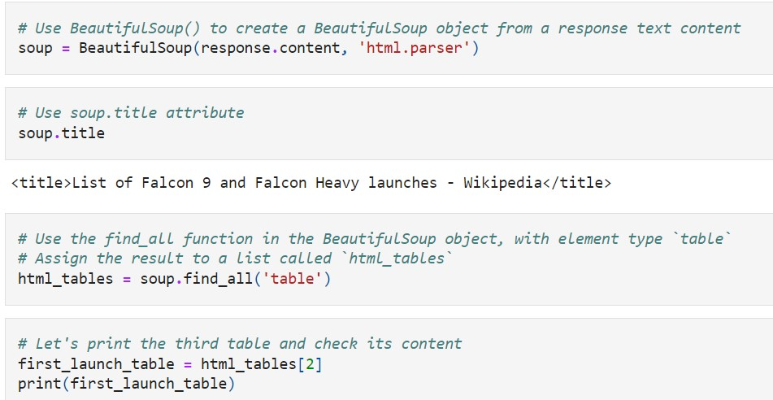
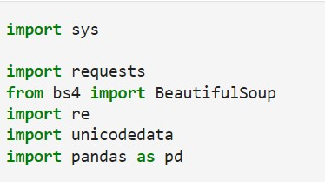
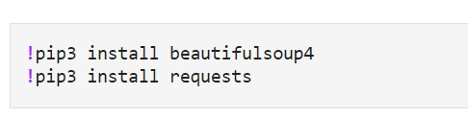
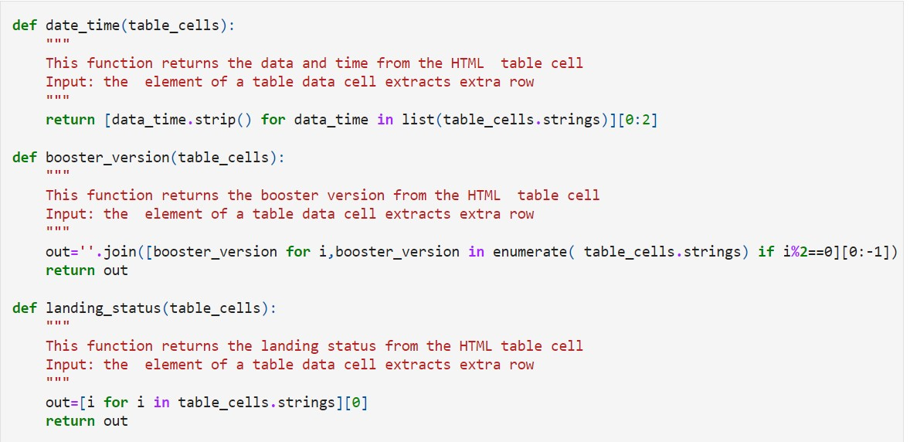
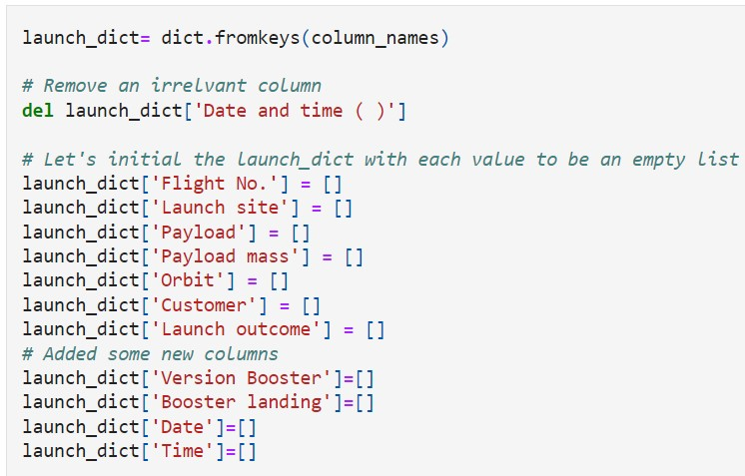
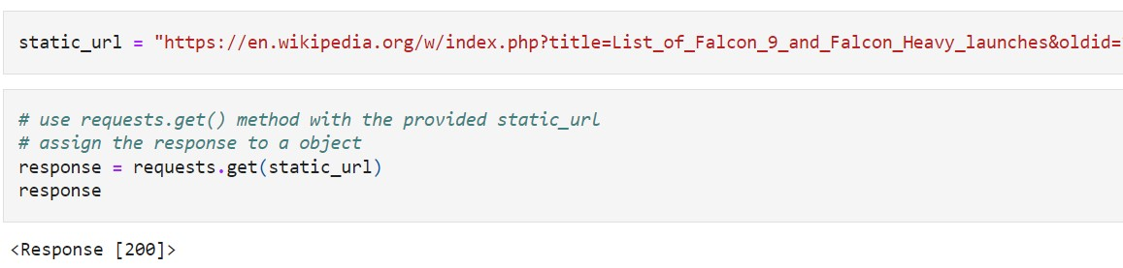
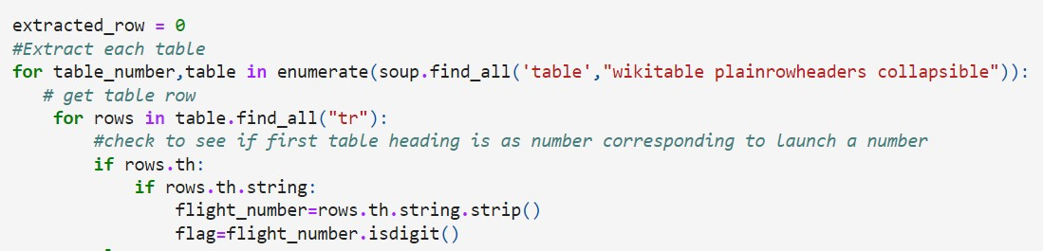
Data Collection - Scraping
3. Create a BeautifulSoup object from the HTML response
4. Collect all relevant column names from the HTML table header
1. Import packages required and helper functions to process web scraped HTML table
5. Create an empty dictionary with keys from the extracted column names
2. Perform an HTTP GET method to request the Falcon9 Launch HTMLWiki page, as an HTTP response
6. Parse launch record values into launch_dict, and create a data frame
GitHub URL

Slide 9
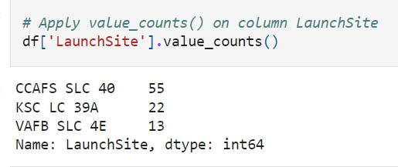
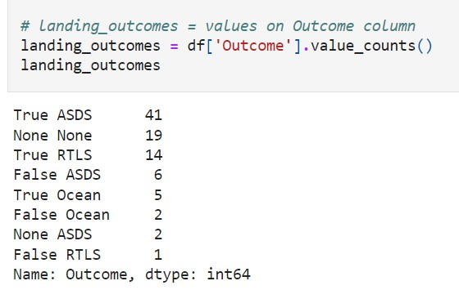
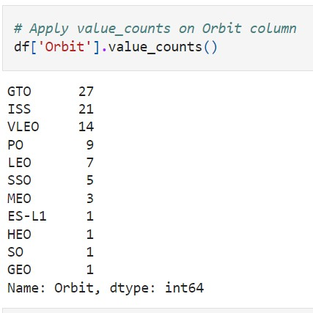
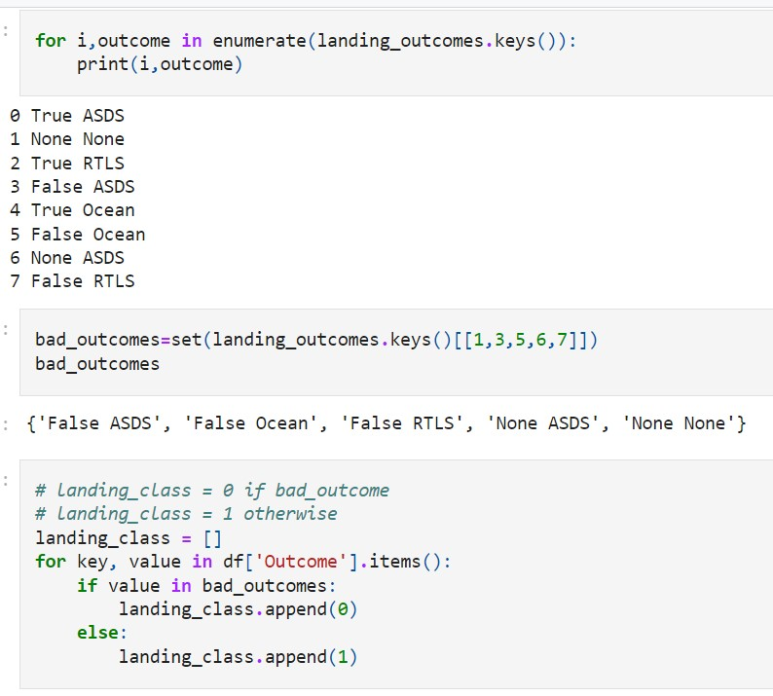

Data Wrangling
Perform Exploratory Data Analysis (EDA) to find patterns in the data and determine what would be the label for training supervised models. Here we convert mission outcomes into Training Labels with 1 means the booster successfully landed and 0 means it was unsuccessful.
1. Determine the number of launches on each site
3. The number of landing outcomes was counted:
True Ocean: successfully landed to a region of the ocean
False Ocean: unsuccessfully landed to a region of the ocean
True RTLS: successfully landed to a ground pad
False RTLS: unsuccessfully landed to a ground pad.
True ASDS: successfully landed to a drone ship
False ASDS: unsuccessfully landed to a drone ship. None ASDS: failure to land
None None: failure to land
2. Each launch aims to a dedicated orbit. The number of occurrences at each orbit was counted.
4. Landing class was created to classify:
1 = Landed successfully
0 = Land unsuccessful (bad outcome)
Success rate:
print(df["Class"].mean())
0.6666666666666666
GitHub URL

Slide 10
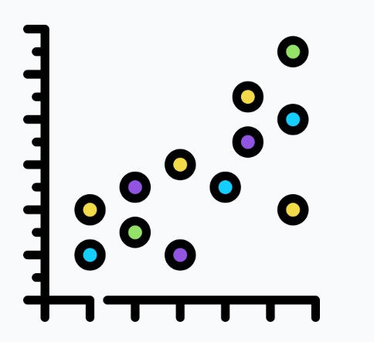


EDA with Data Visualization
Line Graph
Scatter Plots
Scatter plot graphs present the relationship between two variables in a data set
A line graph is a graphical representation of information that changes over time
Flight Number vs. Payload Mass
Flight Number vs Launch Site
Launch Site vs. Payload Mass
Flight Number vs. Orbit Type
Payload Mass vs Orbit Type
Launch Success Rate vs Year
Bar Graph
A bar graph is a chart that compares different categories of data using rectangular bars that represent the value of the data
Success Rate vs Each Orbit
GitHub URL

Slide 11




EDA with SQL
SQL Queries executed in this project (see GitHub Link for code)
Display the names of the unique launch sites in the space mission
Display 5 records where launch sites begin with the string 'CCA’
Display the total payload mass carried by boosters launched by NASA (CRS)
Display average payload mass carried by booster version F9 v1.1
List the date when the first successful landing outcome in ground pad was achieved.
List the names of the boosters which have success in drone ship and have payload mass greater than 4000 but less than 6000.
List the total number of successful and failure mission outcomes
List the names of the booster versions which have carried the maximum payload mass
List the records which will display the month names, failure landing outcomes in drone ship ,booster versions, launch site for the months in year 2015
Rank the count of successful landing outcomes between the date 04-06-2010 and 20-03-2017 in descending order.
GitHub URL

Slide 12




Build an Interactive Map with Folium
Finding an optimal location for building a launch site
folium.Circle highlighted circle area with a text label on a specific coordinate
marker_color.append('green’) – Successful landing
marker_color.append('red’) – Unsuccessful landing
mouse_position = MousePosition – gets coordinate for a mouse over a point on the map
folium.Marker([record['Lat'], record['Long’]] – Marker to show longitude and latitude of location
distance_marker = folium.Marker( [CaliCoastLat, CaliCoastLong] – Marker to show distance between two sites
Markers are used to show distance between launch site to key locations (railway, highway, coast way, city) and plot a line between them.
A Folium Map is useful as we can see an overview of the launch sites, their proximity to key locations and the number of successful and unsuccessful landings.
GitHub URL

Slide 13

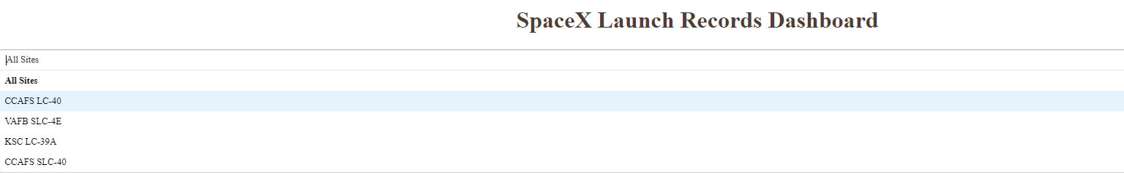
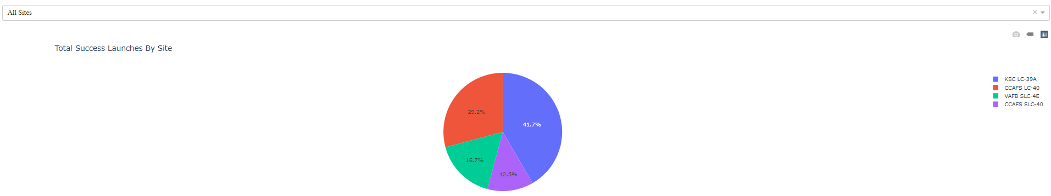
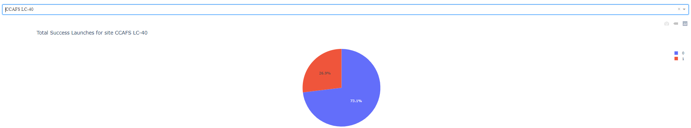
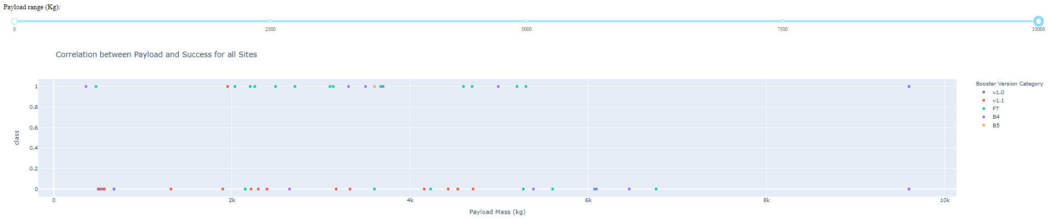
Build a Dashboard with Plotly Dash
A dropdown menu shows the four different launch sites
A pie chart shows the successful launches in the four different launch sites
A pie chart to show the total successful and unsuccessful launches for one launch site
A payload range slider to see if variable payload is correlated to mission outcome
A scatter plot with the x axis to be the payload and the y axis to be the launch outcome to view the correlation
GitHub URL

Slide 14
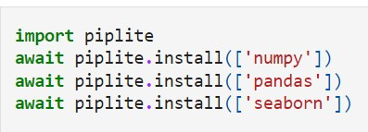
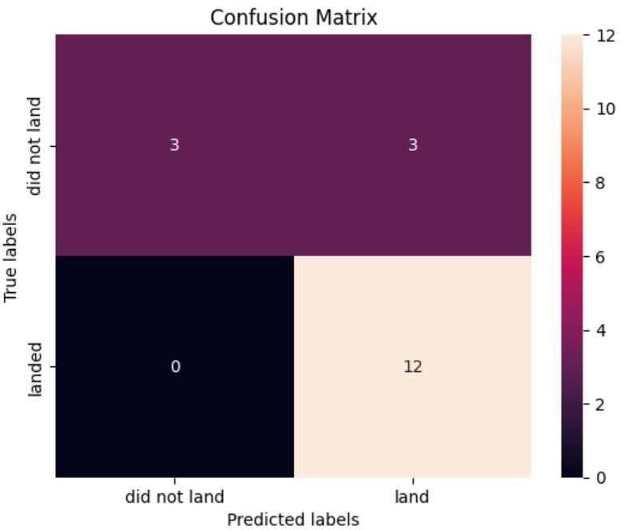
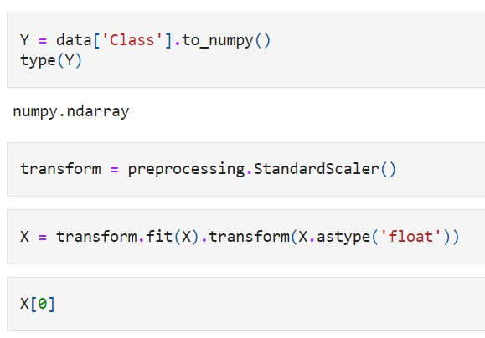
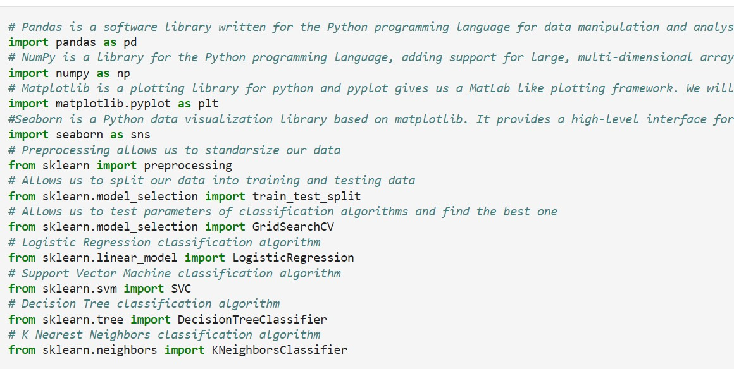
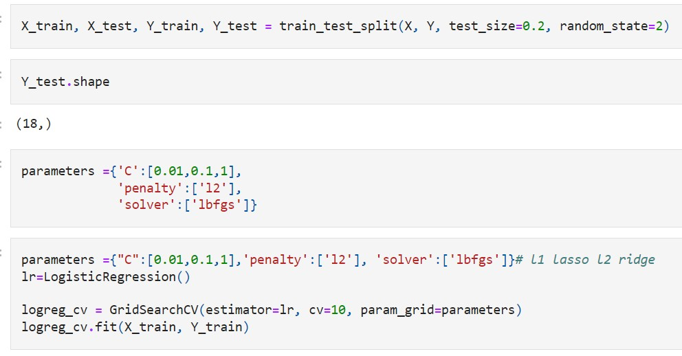
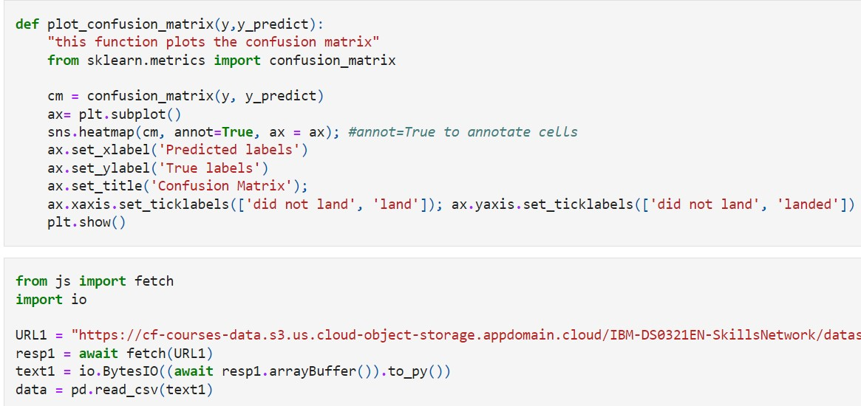
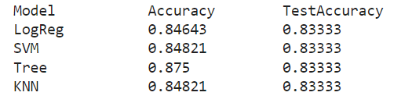

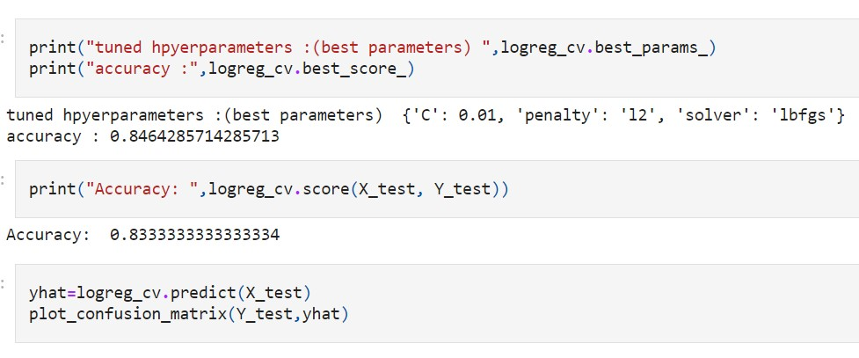
Predictive Analysis (Classification)
Perform exploratory Data Analysis and determine Training Labels and find the method which performs best using test data (SVM, Classification Trees or Logistic Regression)
6. Plot confusion matrixes for logistic regression, SVM, Decision Trees and KNN.
3. Create a NumPy array from the column Class in data, standardize the data using StandardScaler(), use the function train_test_split to split the data X and Y into training and test data.
1. Import Libraries and Define Auxiliary Functions
2. Import function to plot a confusion matrix and load the data
4. We now have 18 test samples
The method which performs best is a Decision Tree with 0.875 Accuracy
5. Create a logistic regression object then create a GridSearchCV object. We display the best parameters and the accuracy on the validation data.
GitHub URL

Slide 15
Results
Exploratory data analysis results
Interactive analytics demo in screenshots
Predictive analysis results

Slide 16

Section 2

Slide 17
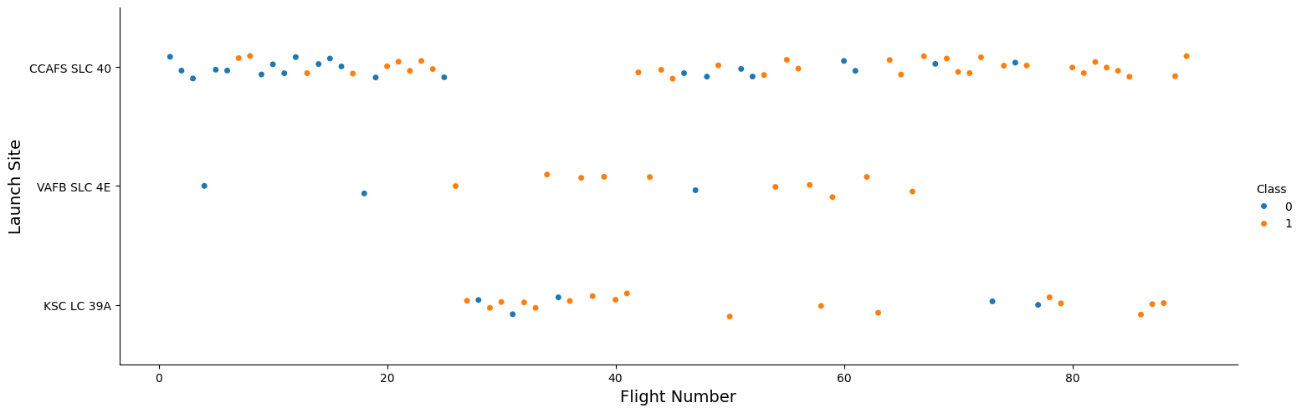
Flight Number vs. Launch Site
Class Key:
Blue (0) – Unsuccessful
Orange (1) - Successful
A scatter plot of Flight Number vs. Launch Site
The scatter plot shows that the launch site of KSC LC 39A had 17 successful and 5 unsuccessful landings. VAFB SLC 4E had 10 successful and 3 unsuccessful landings. And CCAFS SLC 40 had 33 successful and 22 unsuccessful landings.
We can see that the earlier flight numbers had a higher percentage of unsuccessful landings compared to the later flight numbers.
This suggests that landing success rate improved over time.

Slide 18
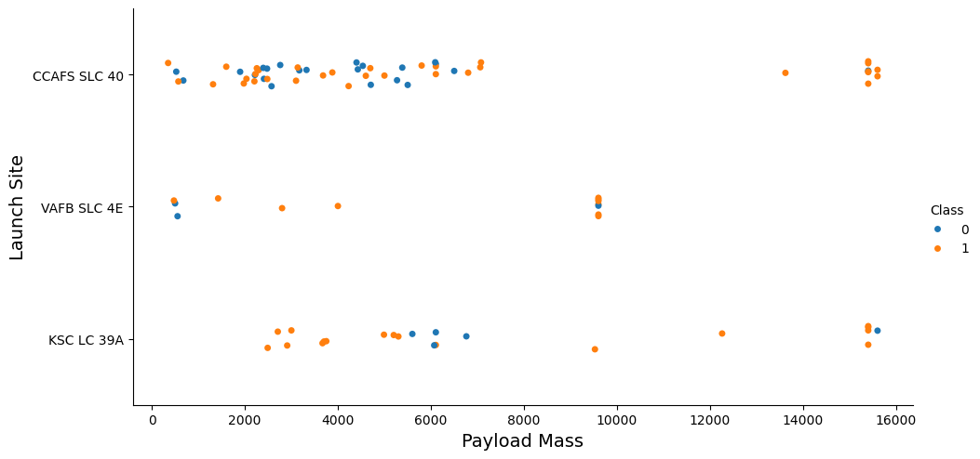
Payload vs. Launch Site
A scatter plot of Payload Mass vs. Launch Site
Class Key:
Blue (0) – Unsuccessful
Orange (1) - Successful
The scatter plot of Payload Mass vs. Launch Site shows clusters of successful landings when the Payload Mass is higher compared to unsuccessful landings. There are more unsuccessful landings at the lower end of the Payload Mass scale. This shows there is a higher chance of a successful landing if the Payload Mass is greater.

Slide 19
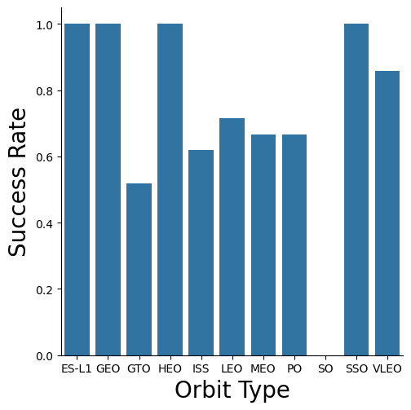

Success Rate vs. Orbit Type
A bar chart of Orbit Type vs. Success Rate (%)
This bar chart shows the relationship between Orbit Type and Success Rate.
We can see that the SO orbit has had no success at 0%. Whereas ES-L1, GEO, HEO, SSO all have a high success rate of 100%.
It is noteworthy to add that VLEO has a high success rate of over 80%.
GTO, ISS, LEO, MEO and PO fall between 50 – 70% success.

Slide 20
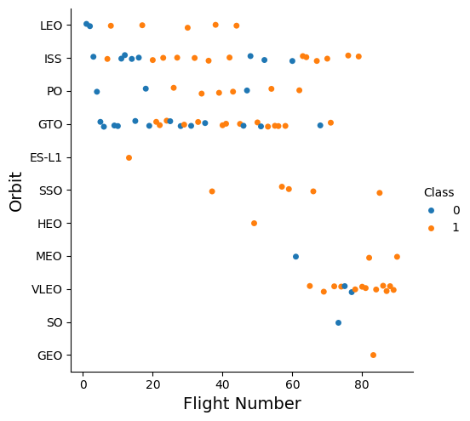
Flight Number vs. Orbit Type
A scatter plot of Flight Number vs. Orbit Type
This scatter plot shows the relationship between the flight number and orbit type.
There are a higher number of unsuccessful landings in the earlier flight numbers at LEO, ISS, PO and GTO.
Success rate appears to increase in the later flights. It is noteworthy to add that VLEO had a high number of successful landings from flight 60 onwards.
Class Key:
Blue (0) – Unsuccessful
Orange (1) - Successful

Slide 21
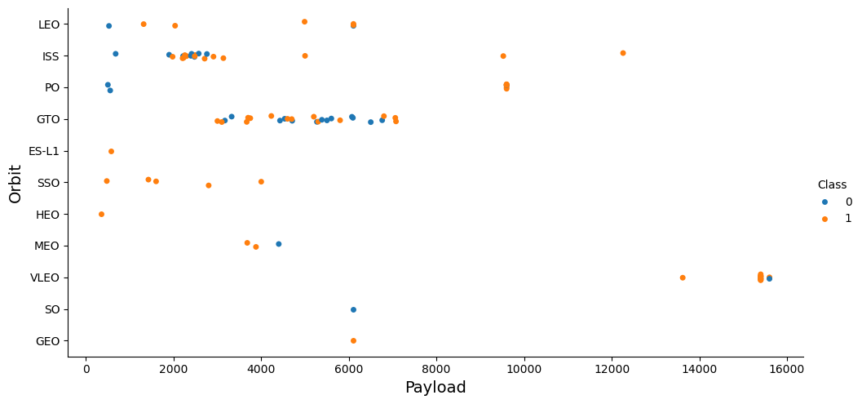
Payload vs. Orbit Type
A scatter plot of Payload Mass (kg) vs. Orbit Type
Class Key:
Blue (0) – Unsuccessful
Orange (1) - Successful
Altitude of Orbits from Earth
GTO Geosynchronous Orbit: 35,786 km
HEO Geocentric Orbits: 35, 786 km
GEO Geosynchronous Orbit: 35, 786 km
MEO Geocentric Orbit: 22,236 km
LEO: Low Earth Orbit: 2,000 km
VLEO: Very Low Earth Orbit: 450 km
A scatter plot to show the relationship between payload and orbit type. We can see that VLEO has the highest successful payload at approx. 16,000kg. The further orbits (GEO, HEO and GTO have only successfully reached a payload of approx. 8,000 kg. This could suggest that a launch to a Very Low Earth Orbit (450 km from earth) can successfully carry a heavier payload.

Slide 22
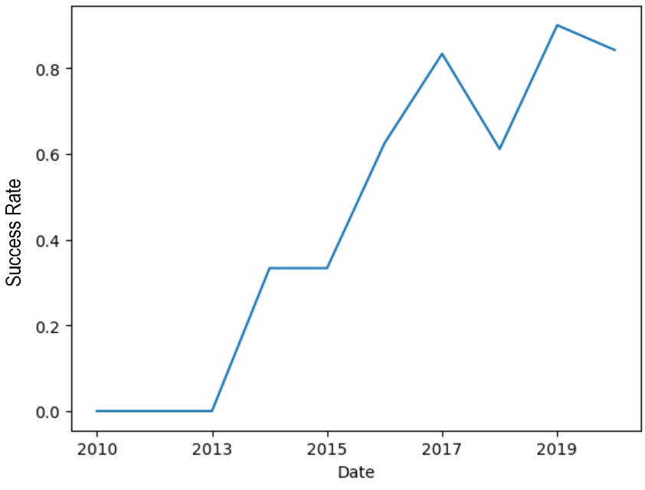

Launch Success Yearly Trend
A line graph of Date vs. Success Rate
A line graph to show the trend of yearly success rates.
We can see that success began in 2013 and has continued to rise.
There was a decline in the year 2018 (60%), however it made a sharp rise thereafter above 80%.

Slide 23
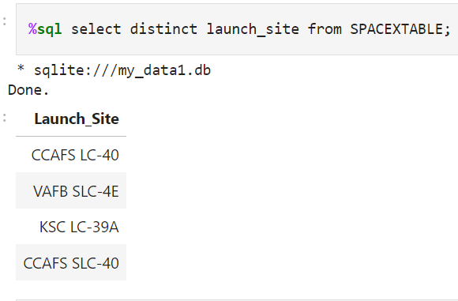

All Launch Site Names
SQL query to find the distinct launch sites from the SPACEXTABLE.
The query returned four sites (CCAFS –LC40, VARB SLC-4E, KSC LC-39A and CCAFS SLC-40)

Slide 24
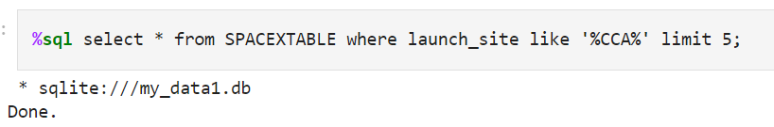
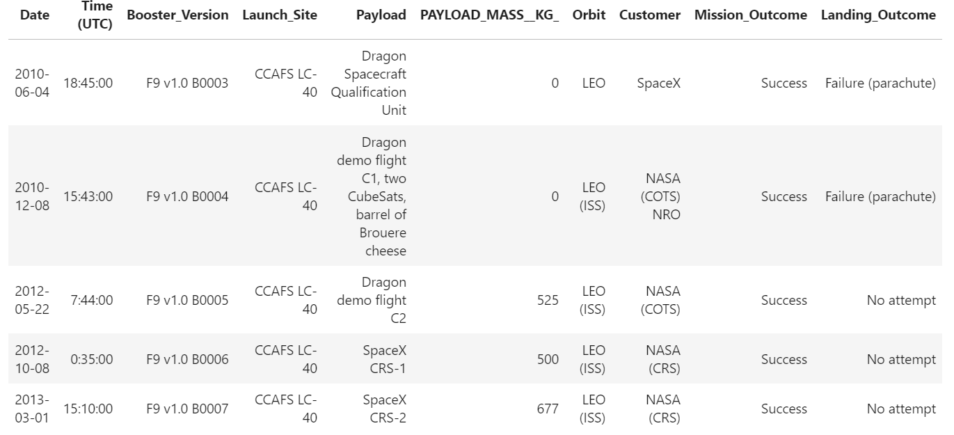
Launch Site Names Begin with 'CCA'
SQL Query to find 5 records where launch sites begin with `CCA` from SPACEXTABLE
%CCA% will return all results with CCA in the name e.g. CCAFS LC-40. Limit 5 will return only the first 5 records.

Slide 25
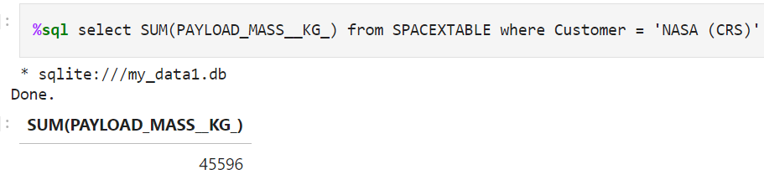
Total Payload Mass
SQL Query to calculate the total payload carried by boosters from the customer NASA from SPACEXTABLE. The result shows the total Payload Mass for NASA (CRS) boosters is 45, 596 kg.

Slide 26
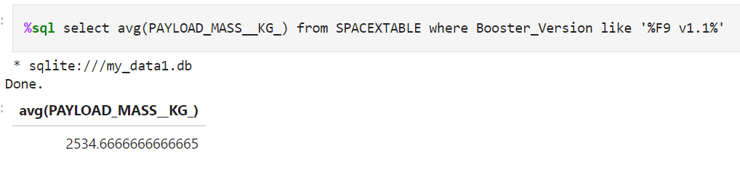
Average Payload Mass by F9 v1.1
SQL Query to calculate the average payload mass carried by booster version F9 v1. The query returns the average payload mass to be 2,534.6 kg.

Slide 27
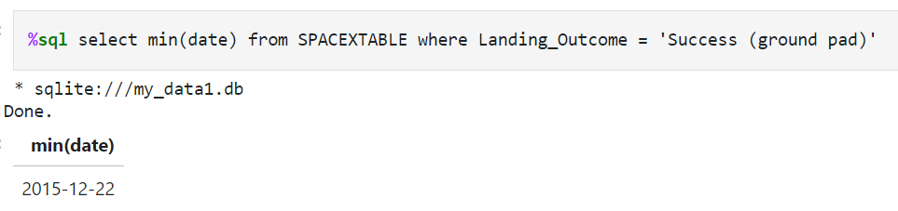
First Successful Ground Landing Date
SQL Query to find the date of the first successful landing outcome on ground pad from SPACEXTABLE. The results have shown that the first successful landing is 22nd December 2015.

Slide 28
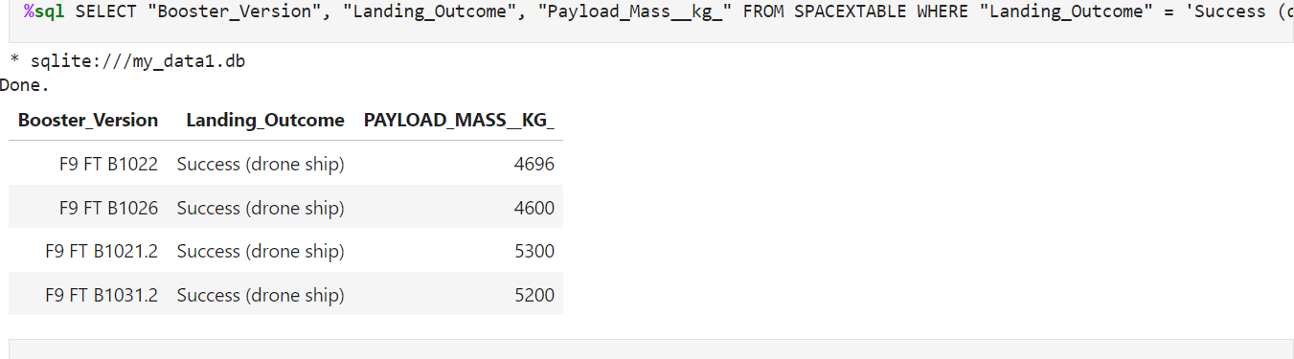
Successful Drone Ship Landing with Payload between 4000 and 6000
SQL Query to list the names of boosters which have successfully landed on drone ship and had payload mass greater than 4000 but less than 6000. This query shows that four boosters (F9 FT B1022, F9 FT B1026, F9 FT B1021.2 and F9 FT B1031.2) have successfully landed on a drone ship with the payloads ranging from 4696 kg – 5200 kg.

Slide 29
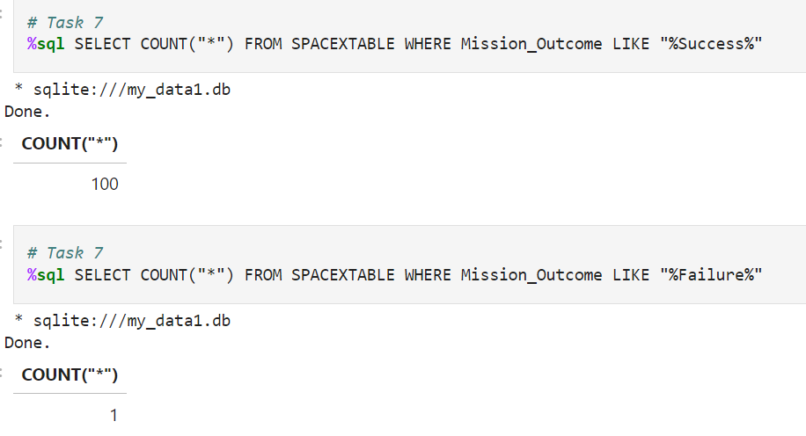
Total Number of Successful and Failure Mission Outcomes
SQL Query to calculate the total number of successful and failure mission outcomes.
Two queries were executed to show success count (100) and failure count (1).

Slide 30
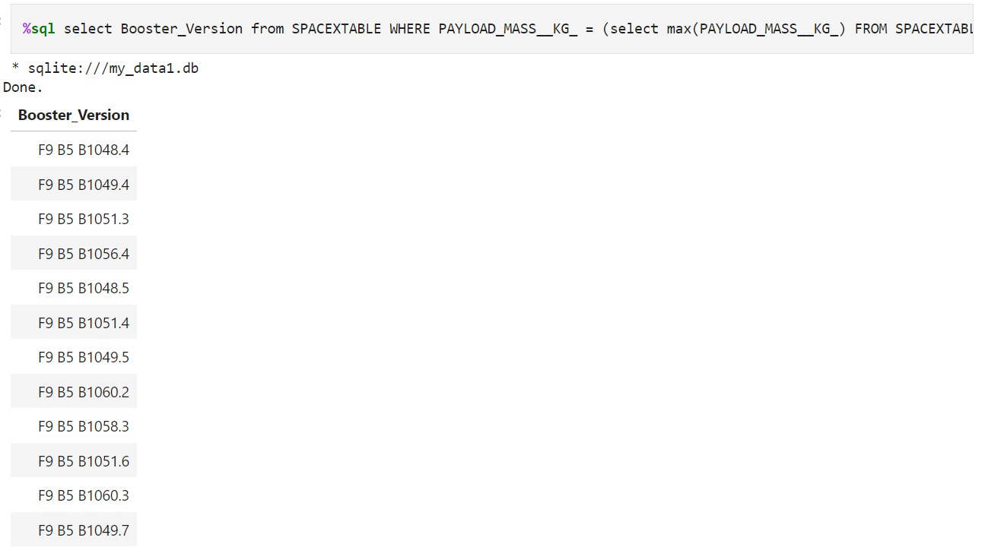
Boosters Carried Maximum Payload
SQL Query to list the names of the booster which have carried the maximum payload mass. The query returned a list of twelve F9 B5 boosters which have carried the maximum payload mass.

Slide 31
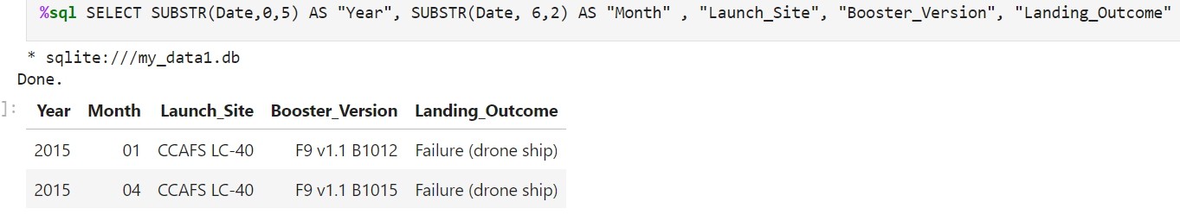
2015 Launch Records
SQL Query to list the failed landing outcomes in drone ship, their booster versions, and launch site names for in year 2015.
This query returned two results which matched the criteria. We can see it is the boosters F9 v1.1 B1012 and B1015 at the same launch site (CCAFS LC-40) in January (Month 01) and April (Month 04) in the year 2015.

Slide 32
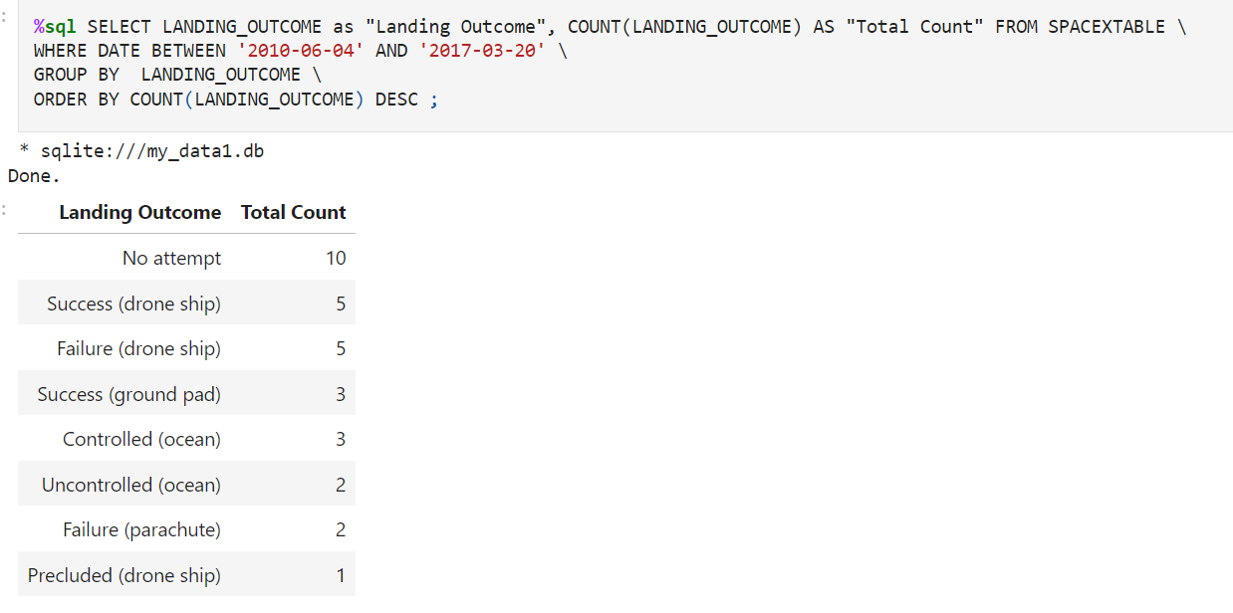
Rank Landing Outcomes Between 2010-06-04 and 2017-03-20
SQL Query to rank the count of landing outcomes (such as Failure (drone ship) or Success (ground pad)) between the date 2010-06-04 and 2017-03-20, in descending order. The query returned a list of landing outcomes in descending order.
The GROUP BY and ORDER BY clause was applied to group into landing outcomes and order by descending count.

Slide 33

Section 3

Slide 34
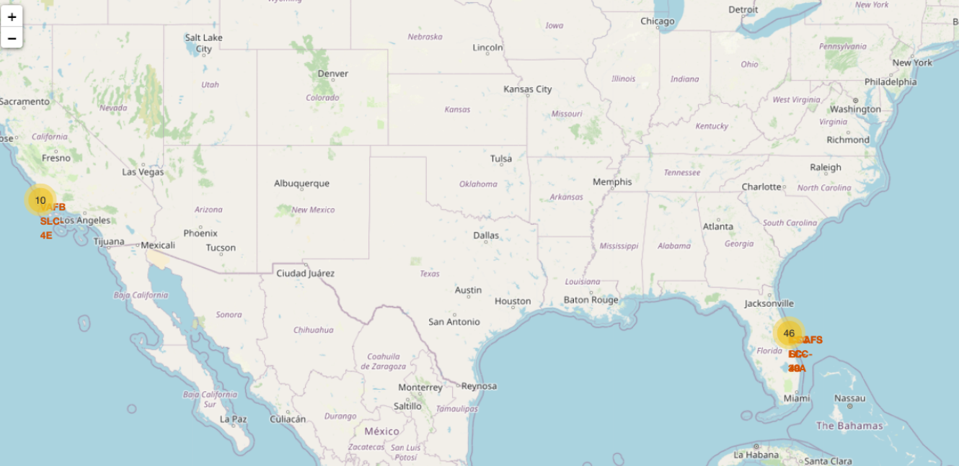
Folium Map of Launch Sites in USA
The Folium Map shows the location of launch sites in the USA.
There are locations by the coastlines in Florida and Los Angeles.

Slide 35

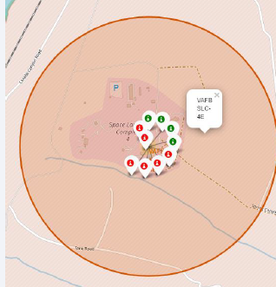



Folium Map of Coloured Markers
The Folium Map shows coloured markers at launch sites.
Green Markers denote a successful launch and red markers represent a failure.
For example, from these images, we can see KSC LC-39A had 10 successful launches and 3 failed attempts. This site had a higher launch success rate compared to the other locations shown.

Slide 36







Folium Map: Distances between CCAFS SLC 40 and its proximities
CCAFS SLC 40 is 0.60 km from the nearest railway line
CCAFS SLC 40 is 23.18 km from the nearest city (Titusville, FL)
CCAFS SLC 40 is 1.29 km from the nearest highway
CCAFS SLC 40 is 0.87 km from the coastline
CCAFS SLC 40 is a good location as it is far from the nearest city and close to the coastline away from civilisation.

Slide 37

Section 4

Slide 38


Pie Chart: Launch success count for all sites
From the Pie Chart, we can see that KSC LC-39A has the highest success rate at 41.7%.
From the Pie Chart, we can see that CCAFS SLC-40 has the lowest success rate at 12.5%.

Slide 39


Pie Chart: Success rate for KSC LC-39A
KSC LC-39A was the launch site with the highest success rate with 76.9% success and 23.1% failure.

Slide 40


Payload vs. Launch Outcome scatter plot for all sites
The correlation between Payload and Success for all sites (0 – 5000 kg) Payload Mass
This scatter plot shows higher success rates for lower payload mass.
The correlation between Payload and Success for all sites (5000 – 10000 kg) Payload Mass
This scatter plot shows higher failure rates with higher payload mass.

Slide 41

Section 5

Slide 42


Classification Accuracy
From the bar chart, we can see that the Decision Tree Model is slightly more accurate with 0.875

Slide 43


Confusion Matrix
The Confusion Matrix for the Decision Tree model shows: 3 True Negative, 3 False Positive, 0 False Negative and 12 True Positive.
A False Positive could cause an issue as it would predict an unsuccessful landing to be successful.

Slide 44
Conclusions
At the launch sites, we can see that the earlier flight numbers had a higher percentage of unsuccessful landings compared to the later flight numbers. This suggests that landing success rate improved over time. We can see that success began in 2013 and has continued to rise. The results have shown that the first successful ground landing is 22nd December 2015.
The orbit types ES-L1, GEO, HEO, SSO have a high success rate of 100%. It is noteworthy to add that VLEO has a high success rate of over 80%. Success rate appears to increase in the later flights. VLEO had a high number of successful landings from flight 60 onwards.
We can see that VLEO has the highest successful payload at approx. 16,000kg. The further orbits (GEO, HEO and GTO have only successfully reached a payload of approx. 8,000 kg. This could suggest that a launch to a Very Low Earth Orbit (450 km from earth) can successfully carry a heavier payload.
From the Pie Chart of all launch sites, we can see that KSC LC-39A has the highest success rate at 41.7%. Furthermore, KSC LC-39A was the launch site with the highest success rate with 76.9% success and 23.1% failure.
From Machine Learning Prediction, we can see that the Decision Tree Model is slightly more accurate with 0.875. The Confusion Matrix for the Decision Tree model shows: 3 True Negative, 3 False Positive, 0 False Negative and 12 True Positive. However, A False Positive could cause an issue as it would predict an unsuccessful landing to be successful.

Slide 45
Appendix
Full Github Repository: https://github.com/beckypotter3/IBMDataScienceMachineCapstone/tree/main
Data from Space X API: https://api.spacexdata.com/v4/launches/past
Data of Falcon 9 Launch data from web scraping Wiki pages: https://en.wikipedia.org/wiki/List_of_Falcon_9_and_Falcon_Heavy_launches

